Slide 1

SCS1301 - OPERATING SYSTEM
UNIT – 2
PROCESS MANAGEMENT
Ms. B KEERTHI SAMHITHA
ASSISTANT PROFESSOR
DEPARTMENT OF CSE
SCHOOL OF COMPUTING

Slide 2
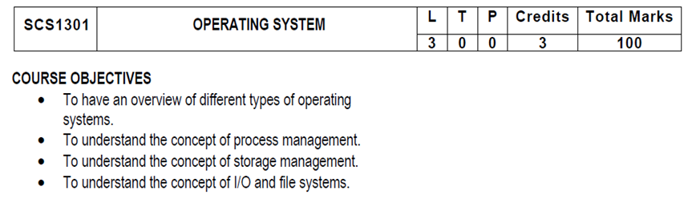
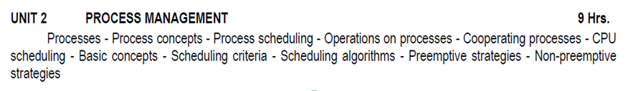
SYLLUBUS

Slide 3
COURSE OUTCOMES
SCS1301.1 | Comprehend knowledge about Operating system components and services.
SCS1301.2 | Apply knowledge of process scheduling algorithms for a given context.
SCS1301.3 | Analyze process synchronization and deadlock conditions.
SCS1301.4 | Construct the process of Mapping logical address to physical address.
SCS1301.5 | Design appropriate strategies for Paging, Segmentation.
SCS1301.6 | Develop real time applications Based on Linux shell programming.

Slide 4
INTRODUCTION TO PROCESSES
Early computer systems allowed only one program to be executed at a time.
Definition : A process is defined as an entity which represents the basic unit of work to be implemented in the system.
A process is basically a program in execution. The execution of a process must progress in a sequential fashion.
A process will need certain resources—such as CPU time, memory, files, and I/O devices —to accomplish its task.
A process is the unit of work in most systems.

Slide 5
Although traditionally a process contained only a single thread of control as it ran, most modern operating systems now support processes that have multiple threads.
A process is the unit of work in a modern time-sharing system.
The more complex the operating system is, the more it is expected to do on behalf of its users.
Systems consist of a collection of processes:
Operating-system processes execute system code, and
User processes execute user code.

Slide 6
PROCESSES
A process is mainly a program in execution where the execution of a process must progress in a sequential order or based on some priority or algorithms.
In other words, it is an entity that represents the fundamental working that has been assigned to a system.
When a program gets loaded into the memory, it is said to as process. This processing can be categorized into 4 sections. These are:
Heap
Stack
Data
Text

Slide 7
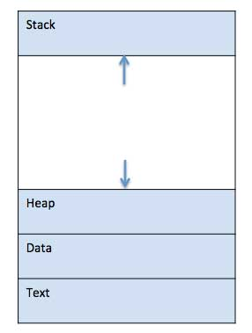
PROCESSES

Slide 8
PROCESSES
Process memory is divided into four sections for efficient working :
Text section is made up of the compiled program code, read in from non-volatile storage when the program is launched.
Data section is made up the global and static variables, allocated and initialized prior to executing the main.
Heap is used for the dynamic memory allocation, and is managed via calls to new, delete, malloc, free, etc.
Stack is used for local variables. Space on the stack is reserved for local variables when they are declared.

Slide 9
What is a Process?
A process is a program in execution.
Process is not as same as program code but a lot more than it.
A process is an 'active' entity as opposed to program which is considered to be a 'passive' entity.
Attributes held by process include hardware state, memory, CPU etc.

Slide 10
PROCESS CONCEPTS
A question that arises in discussing operating systems involves what to call all the CPU activities.
A batch system executes jobs, whereas a time-shared system has user programs, or tasks.
Even on a single-user system such as Microsoft Windows, a user may be able to run several programs at one time: a word processor, a web browser, and an e-mail package.

Slide 11
PROCESS CONCEPTS
Process – a program in execution; process execution must progress in sequential fashion.
A process is a program in execution. A process is more than the program code, which is sometimes known as the text section.
A process includes:
Counter
Program stack
Data section
The current activity, as represented by the value of the program counter and the contents of the processor's registers.
The process stack contains temporary data (such as function parameters, return addresses, and local variables)
A data section, which contains global variables.
Process may also include a heap, which is memory that is dynamically allocated during process run time.

Slide 12
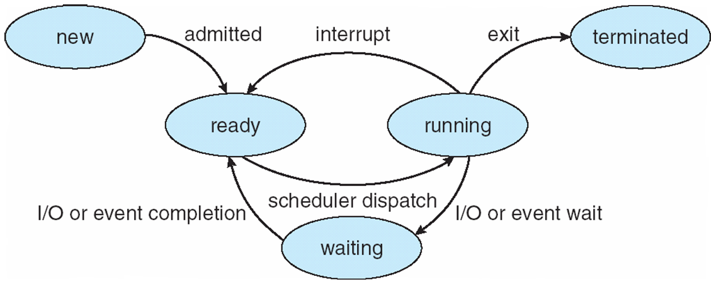
PROCESS STATE / PROCESS LIFE CYCLE

Slide 13
PROCESS STATE
When a process executes, it passes through different states.
These stages may differ in different operating systems, and the names of these states are also not standardized.
In general, a process can have one of the following five states at a time.
New/Start
Running
Waiting
Ready
Terminated

Slide 14
PROCESS STATE
START / NEW
This is the initial state when a process is first started / created.
READY
The process is waiting to be assigned to a processor.
Ready processes are waiting to have the processor allocated to them by the operating system so that they can run.
Process may come into this state after Start state or while running it by but interrupted by the scheduler to assign CPU to some other process.
RUNNING
Once the process has been assigned to a processor by the OS scheduler, the process state is set to running and the processor executes its instructions.

Slide 15
PROCESS STATE
WAITING
Process moves into the waiting state if it needs to wait for a resource, such as waiting for user input, or waiting for a file to become available.
TERMINATED OR EXIT
Once the process finishes its execution, or it is terminated by the operating system, it is moved to the terminated state where it waits to be removed from main memory.
These names are arbitrary, and they vary across operating systems.

Slide 16
PROCESS STATE
NEW- The process is being created.
READY- The process is waiting to be assigned to a processor.
RUNNING- Instructions are being executed.
WAITING- The process is waiting for some event to occur(such as an I/O completion or reception of a signal).
TERMINATED- The process has finished execution.

Slide 17
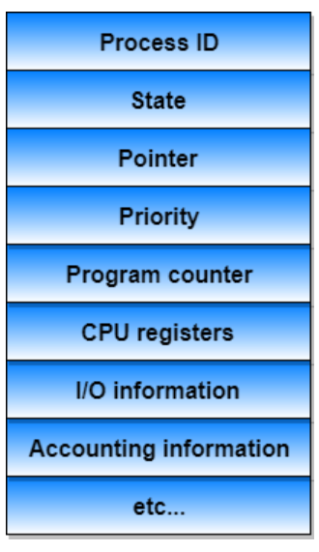
PROCESS CONTROL BLOCK (PCB)
Information associated with each process
(also called task control block)

Slide 18
PCB
There is a Process Control Block for each process, enclosing all the information about the process. It is a data structure, which contains the following:
Process State
It can be running, waiting etc.
Process Privileges
This is required to allow/disallow access to system resources.
Process ID
Unique identification for each of the process in the operating system.

Slide 19
PCB
Pointer
A pointer to parent process.
Program Counter
Program Counter is a pointer to the address of the next instruction to be executed for this process.
CPU Registers
Various CPU registers where process need to be stored for execution for running state.
CPU Scheduling Information
Process priority and other scheduling information which is required to schedule the process.

Slide 20
PCB
Memory Management Information
This includes the information of page table, memory limits, Segment table depending on memory used by the operating system.
Accounting Information
This includes the amount of CPU used for process execution, time limits, execution ID etc.
IO Status Information
This includes a list of I/O devices allocated to the process.

Slide 21
PCB
The architecture of a PCB is completely dependent on Operating System and may contain different information in different operating systems. (shown in the diagram)
The PCB is maintained for a process throughout its lifetime, and is deleted once the process terminates.

Slide 22
PROCESS SCHEDULING
The act of determining which process is in the ready state, and should be moved to the running state is known as Process Scheduling.
AIM : The process scheduling system is to keep the CPU busy all the time and to deliver minimum response time for all programs.
For achieving this, the scheduler must apply appropriate rules for swapping processes IN and OUT of CPU

Slide 23
PROCESS SCHEDULING
Scheduling fell into one of the two general categories:
Non Pre-emptive Scheduling: When the currently executing process gives up the CPU voluntarily.
Pre-emptive Scheduling: When the operating system decides to favour another process, pre-empting the currently executing process.

Slide 24
What are Scheduling Queues?
All processes, upon entering into the system, are stored in the Job Queue.
Processes in the Ready state are placed in the Ready Queue.
Processes waiting for a device to become available are placed in Device Queues. There are unique device queues available for each I/O device.
The OS maintains all PCBs in Process Scheduling Queues.
The OS maintains a separate queue for each of the process states and PCBs of all processes in the same execution state are placed in the same queue.

Slide 25
Scheduling Queues?
Once the process is assigned to the CPU and is executing, one of the following several events can occur:
The process could issue an I/O request, and then be placed in the I/O queue.
The process could create a new sub-process and wait for its termination.
The process could be removed forcibly from the CPU, as a result of an interrupt, and be put back in the ready queue.

Slide 26
Scheduling Queues?
Process migration between the various queues:
Job queue
Ready queue
Device queues
JOB QUEUE − This queue keeps all the processes in the system.
READY QUEUE − This queue keeps a set of all processes residing in main memory, ready and waiting to execute. A new process is always put in this queue.
DEVICE QUEUES − The processes which are blocked due to unavailability of an I/O device constitute this queue.

Slide 27
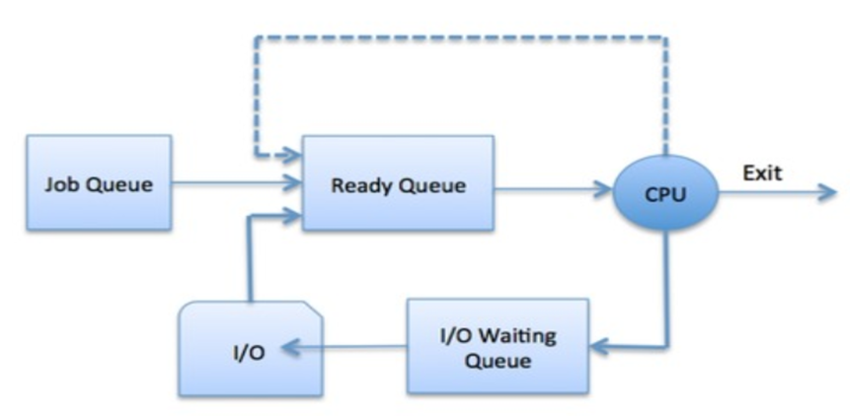
Scheduling Queues?
The OS can use different policies to manage each queue (FIFO, Round Robin, Priority, etc.)

Slide 28
TWO STATE PROCESS MODEL
Two-state process model refers to running and non-running states which are described below
RUNNING
When a new process is created, it enters into the system as in the running state.
NOT RUNNING
Processes that are not running are kept in queue, waiting for their turn to execute. Each entry in the queue is a pointer to a particular process. Queue is implemented by using linked list.

Slide 29
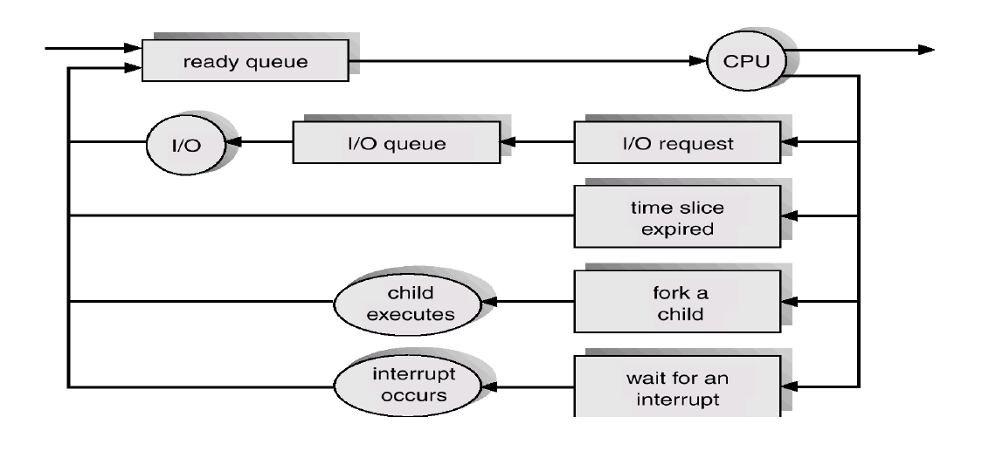
QUEUING DIAGRAM REPRESENTATION FOR PROCESS SCHEDULING

Slide 30
PROCESS SCHEDULING
Each rectangular box represents a queue.
Two types of queues are present:
the ready queue and
a set of device queues
The circles represent the resources that serve the queues, and the arrows indicate the flow of processes in the system.
A new process is initially put in the ready queue.
It waits there until it is selected for execution, or is dispatched.

Slide 31
SCHEDULERS
Schedulers are special system software which handles the process scheduling in various ways.
Their main task is to select the jobs to be submitted into the system and to decide which process to run.
Schedulers are of three types –
Long-Term Scheduler
Short-Term Scheduler
Medium-Term Scheduler

Slide 32
LONG TERM SCHEDULER
It is also called a job scheduler.
A long-term scheduler determines which programs are admitted to the system for processing.
It selects processes from the queue and loads them into memory for execution.
Process loads into the memory for CPU scheduling.

Slide 33
SHORT TERM SCHEDULER
It is also called as CPU scheduler.
Its main objective is to increase system performance in accordance with the chosen set of criteria.
It is the change of ready state to running state of the process.
CPU scheduler selects a process among the processes that are ready to execute and allocates CPU to one of them.
Short-term schedulers, also known as dispatchers, make the decision of which process to execute next.

Slide 34
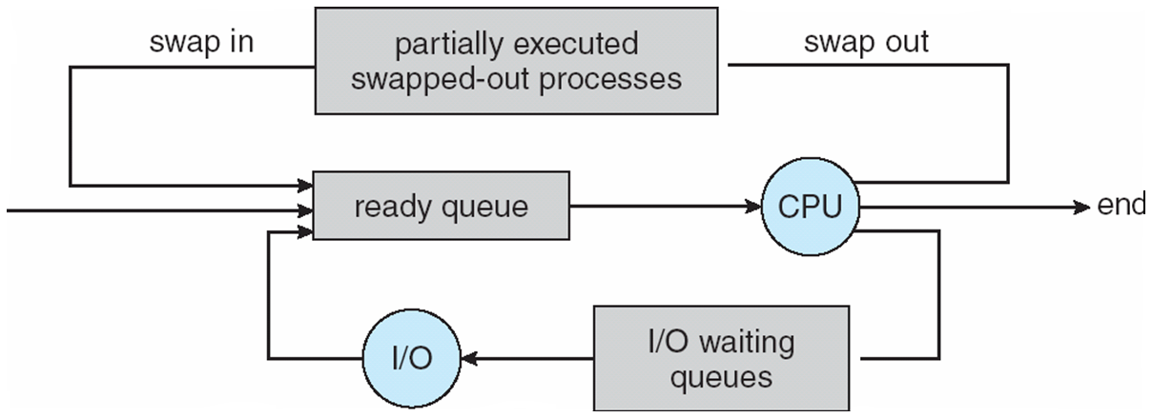
MEDIUM TERM SCHEDULER
Medium-term scheduling is a part of swapping.
It removes the processes from the memory.
The medium-term scheduler is in-charge of handling the swapped out-processes.

Slide 35
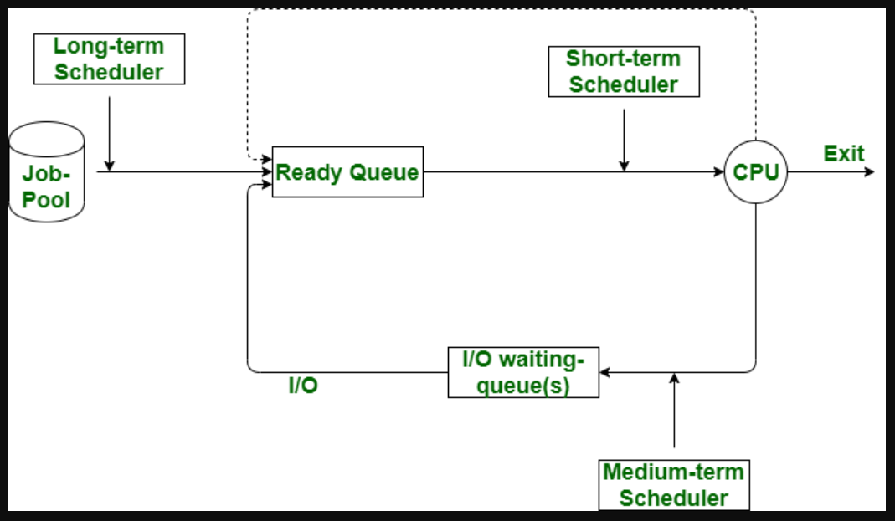

Slide 36
Short-term scheduler (or CPU scheduler) – selects which process should be executed next and allocates CPU
Sometimes the only scheduler in a system
Short-term scheduler is invoked frequently (milliseconds) ⇒ (must be fast)
Long-term scheduler (or job scheduler) – selects which processes should be brought into the ready queue
Long-term scheduler is invoked infrequently (seconds, minutes) ⇒ (may be slow)
The long-term scheduler controls the degree of multiprogramming
Processes can be described as either:
I/O-bound process – spends more time doing I/O than computations, many short CPU bursts
CPU-bound process – spends more time doing computations; few very long CPU bursts
Long-term scheduler strives for good process mix

Slide 37
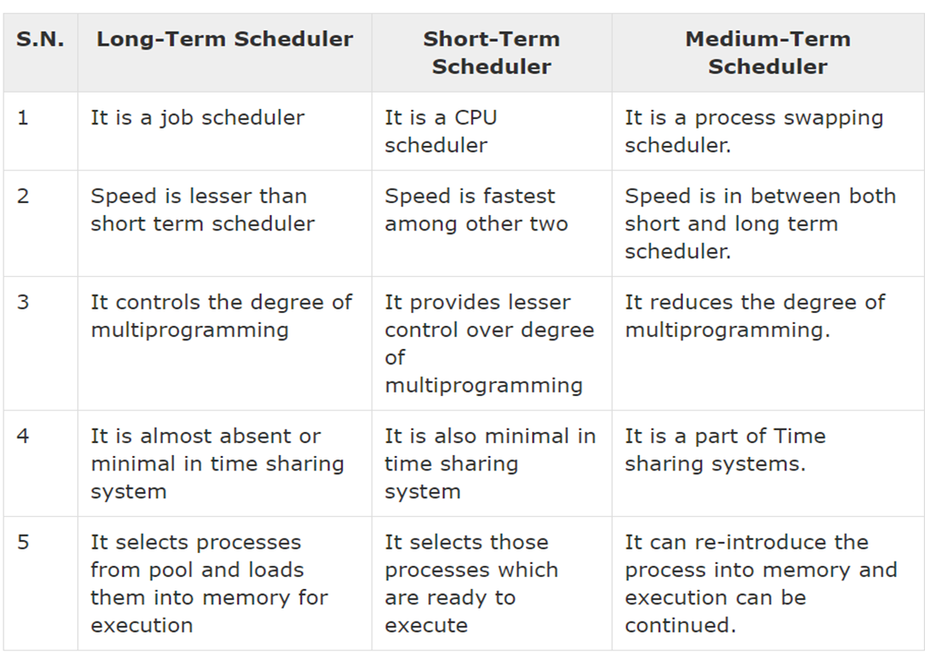

Slide 38
CONTEXT SWITCH
Switching the CPU to another process requires saving the state of the old process and loading the saved state for the new process. This task is known as a Context Switch.
The context of a process is represented in the Process Control Block(PCB) of a process; it includes the value of the CPU registers, the process state and memory-management information.
Context switch time is pure overhead, because the system does no useful work while switching. Its speed varies from machine to machine, depending on the memory speed.

Slide 39
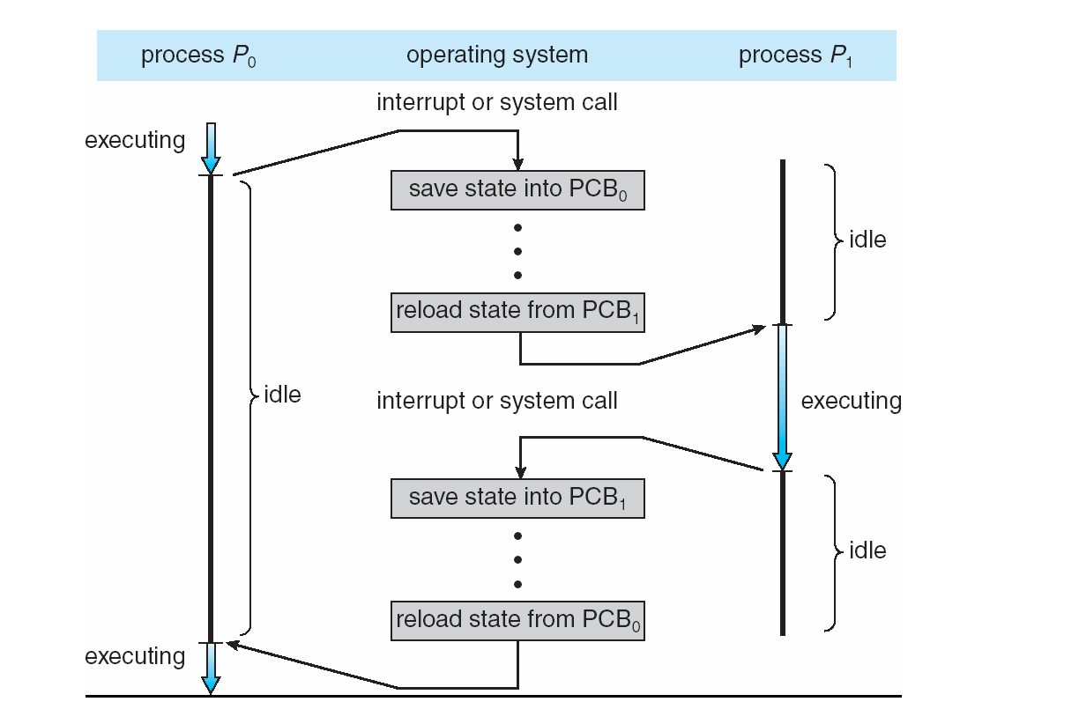

Slide 40
OPERATIONS ON PROCESSES
The processes in the system can execute concurrently, and they must be created and deleted dynamically
The two major operation Process Creation and Process Termination.

Slide 41
PROCESS CREATION
Through appropriate system calls, such as fork or spawn, processes may create other processes.
The process which creates other process, is termed the parent of the other process, while the created sub-process is termed its child.
Parent process creates children processes, which, in turn create other processes, forming a tree of processes.
Resource sharing
Parent and children share all resources.
Children share subset of parent’s resources.
Parent and child share no resources.
Execution
Parent and children execute concurrently.
Parent waits until children terminate.

Slide 42
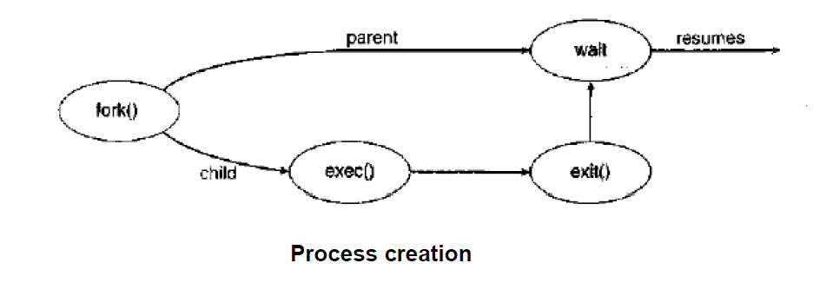
PROCESS CREATION

Slide 43
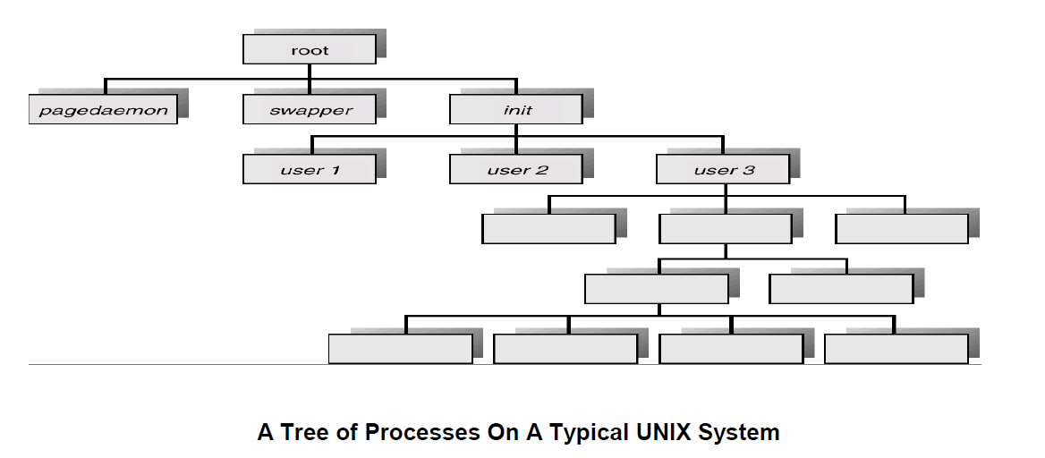
PROCESS CREATION

Slide 44
PROCESS TERMINATION
Process executes last statement and then asks the operating system to delete it using the exit() system call.
Returns status data from child to parent (via wait())
Process’ resources are deallocated by operating system
Parent may terminate the execution of children processes using the abort() system call. Some reasons for doing so:
Child has exceeded allocated resources
Task assigned to child is no longer required
The parent is exiting and the operating systems does not allow a child to continue if its parent terminates

Slide 45
COOPERATING PROCESSES
Processes executing concurrently in the operating system may be either independent processes or cooperating processes.
A process is independent if it cannot affect or be affected by the other processes executing in the system.
Any process that does not share data with any other process is independent.
There are several reasons for providing an environment that allows process cooperation:
INFORMATION SHARING
COMPUTATION SPEEDUP
MODULARITY
CONVENIENCE
BUFFER

Slide 46
COOPERATING PROCESSES
INFORMATION SHARING:
Since several users may be interested in the same piece of information (for instance, a shared file), we must provide an environment to allow concurrent access to such information.
COMPUTATION SPEEDUP:
If we want a particular task to run faster, we must break it into subtasks, each of which will be executing in parallel with the others.
MODULARITY:
We may want to construct the system in a modular fashion, dividing the system functions into separate processes or threads
CONVENIENCE
Even an individual user may work on many tasks at the same time

Slide 47
Producer-Consumer Problem
Paradigm for cooperating processes, producer process produces information that is consumed by a consumer process
unbounded-buffer places no practical limit on the size of the buffer
bounded-buffer assumes that there is a fixed buffer size
https://www.youtube.com/watch?v=LRiN3DJdskA

Slide 48
CPU SCHEDULING
CPU scheduling is a process which allows one process to use the CPU while the execution of another process is on hold(in waiting state)
This is due to unavailability of any resource like I/O etc, thereby making full use of CPU.
The aim of CPU scheduling is to make the system efficient, fast and fair.
The aim of CPU scheduling is to make the system efficient, fast and fair
Whenever the CPU becomes idle, the operating system must select one of the processes in the ready queue to be executed.

Slide 49
CPU SCHEDULING: DISPATCHER
Another component involved in the CPU scheduling function is the Dispatcher.
The dispatcher is the module that gives control of the CPU to the process selected by the short-term scheduler.
This function involves:
Switching context
Switching to user mode
Jumping to the proper location in the user program to restart that program from where it left last time.

Slide 50
CPU SCHEDULING: DISPATCHER
The dispatcher should be as fast as possible, given that it is invoked during every process switch. The time taken by the dispatcher to stop one process and start another process is known as the Dispatch Latency.
Types of CPU Scheduling
When a process switches from the running state to the waiting state (for I/O request or invocation of wait for the termination of one of the child processes).
When a process switches from the running state to the ready state (for example, when an interrupt occurs).
When a process switches from the waiting state to the ready state (for example, completion of I/O).
When a process terminates.

Slide 51
CPU SCHEDULING: SCHEDULING CRITERIA
Different CPU scheduling algorithms have different properties, and the choice of a particular algorithm may favor one class of processes over another.
Many criteria have been suggested for comparing CPU scheduling algorithms.
Which characteristics are used for comparison can make a substantial difference in which algorithm is judged to be best.
CPU UTILIZATION
THROUGHPUT
TURNAROUND TIME
WAITING TIME
LOAD AVERAGE
RESPONSE TIME

Slide 52
CPU SCHEDULING: SCHEDULING CRITERIA
CPU UTILIZATION
We want to keep the CPU as busy as possible.
Conceptually, CPU utilization can range from 0 to 100 percent.
THROUGHPUT
It is the total number of processes completed per unit time or rather say total amount of work done in a unit of time.
TURNAROUND TIME
It is the amount of time taken to execute a particular process, i.e. The interval from time of submission of the process to the time of completion of the process (Wall clock time).

Slide 53
CPU SCHEDULING: SCHEDULING CRITERIA
WAITING TIME
The sum of the periods spent waiting in the ready queue amount of time a process has been waiting in the ready queue to acquire get control on the CPU.
LOAD AVERAGE
It is the average number of processes residing in the ready queue waiting for their turn to get into the CPU.
RESPONSE TIME
Amount of time it takes from when a request was submitted until the first response is produced. Remember, it is the time till the first response and not the completion of process execution (final response).

Slide 54
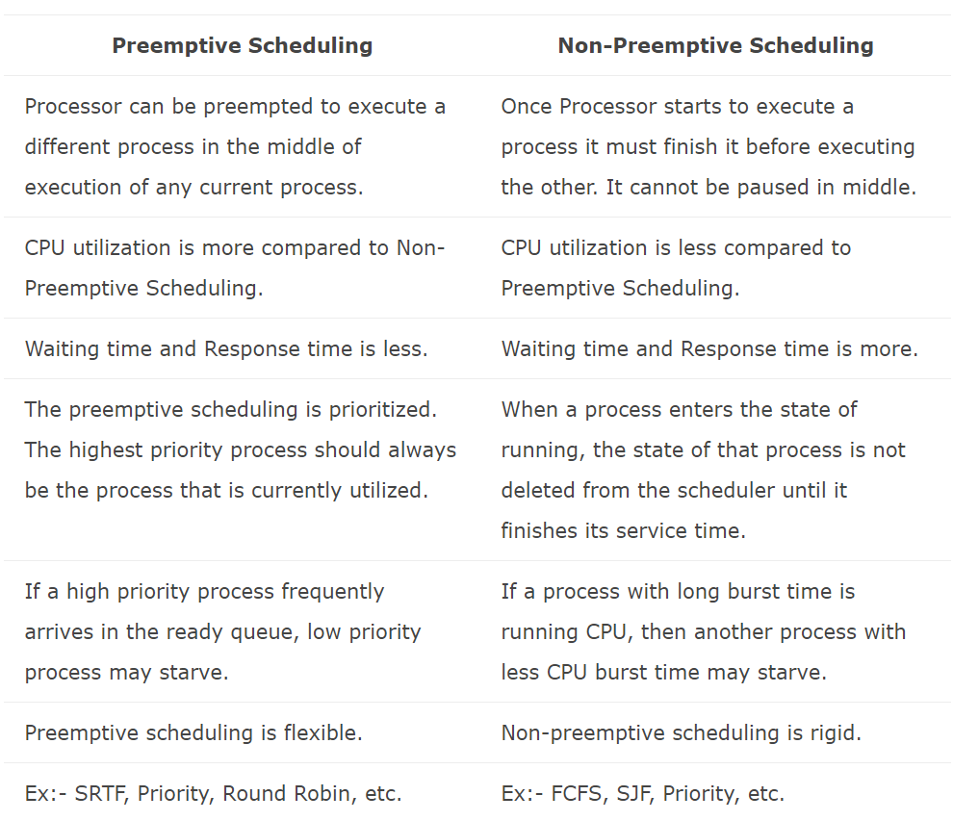
PREEMPTIVE AND NON – PREEMPTIVE

Slide 55
SCHEDULING ALGORITHMS
CPU scheduling deals with the problem of deciding which of the processes in the ready queue is to be allocated the CPU.
There are many different CPU scheduling algorithms:
First Come First Serve (FCFS) Scheduling
Shortest-Job-First (SJF) Scheduling
Priority Scheduling
Shortest Remaining Time (SRT) Scheduling
Round Robin (RR) Scheduling
Multilevel Queue Scheduling
Multilevel Feedback Queue Scheduling

Slide 56
COMMON DEFINITIONS INVOLVED IN CALCULATION PROCESS
ARRIVAL TIME: Time taken for the arrival of each process in the CPU Scheduling Queue.
BURST TIME : The amount of time required by a process for executing on CPU. It is also called as execution time or running time.
COMPLETION TIME: Time taken for the execution to complete, starting from arrival time.
TURN AROUND TIME: Time taken to complete after arrival. In simple words, it is the difference between the Completion time and the Arrival time.
WAITING TIME: Total time the process has to wait before it's execution begins. It is the difference between the Turn Around time and the Burst time of the process.

Slide 57
FCFS - FIRST COME FIRST SERVE SCHEDULING
In the "First come first serve" scheduling algorithm, as the name suggests, the process which arrives first, gets executed first
We can say that the process which requests the CPU first, gets the CPU allocated first.
Jobs are executed on first come, first serve basis.
It is a non-preemptive, pre-emptive scheduling algorithm.
Easy to understand and implement.
Its implementation is based on FIFO queue.
Poor in performance as average wait time is high.

Slide 58
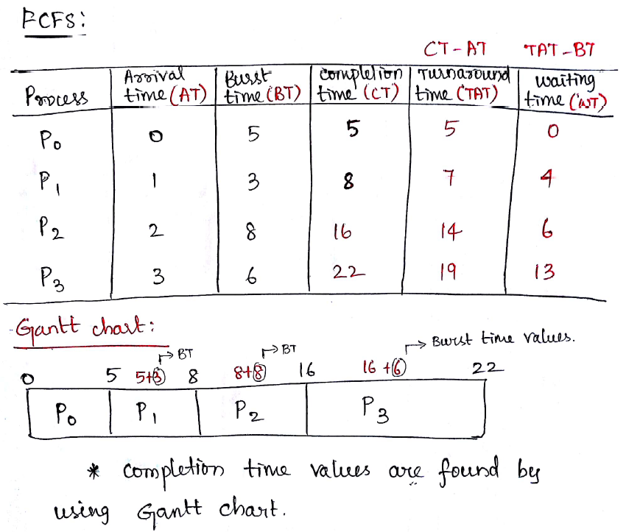
EXAMPLE

Slide 59
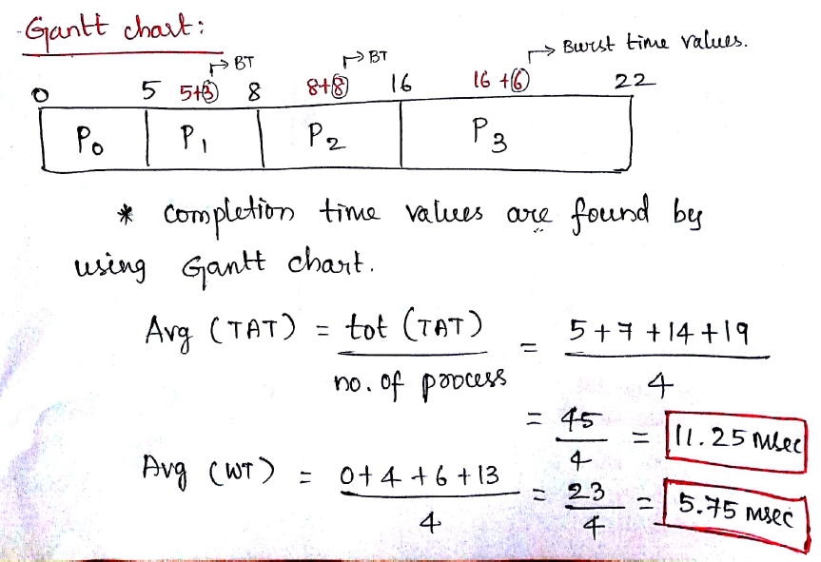

Slide 60
SJF – SHORTEST JOB FIRST SCHEDULING
This is also known as shortest job next, or SJN
This is a non-preemptive, pre-emptive scheduling algorithm.
Best approach to minimize waiting time.
Easy to implement in Batch systems where required CPU time is known in advance.
Impossible to implement in interactive systems where required CPU time is not known.
The processer should know in advance how much time process will take.

Slide 61
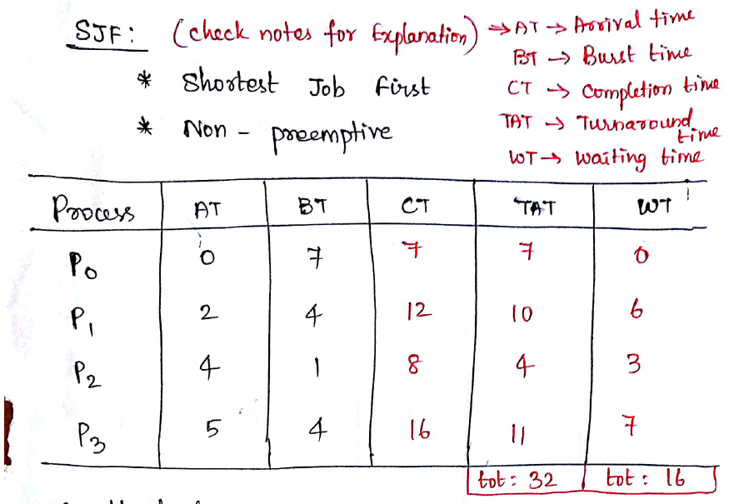

Slide 62
